Slide 1

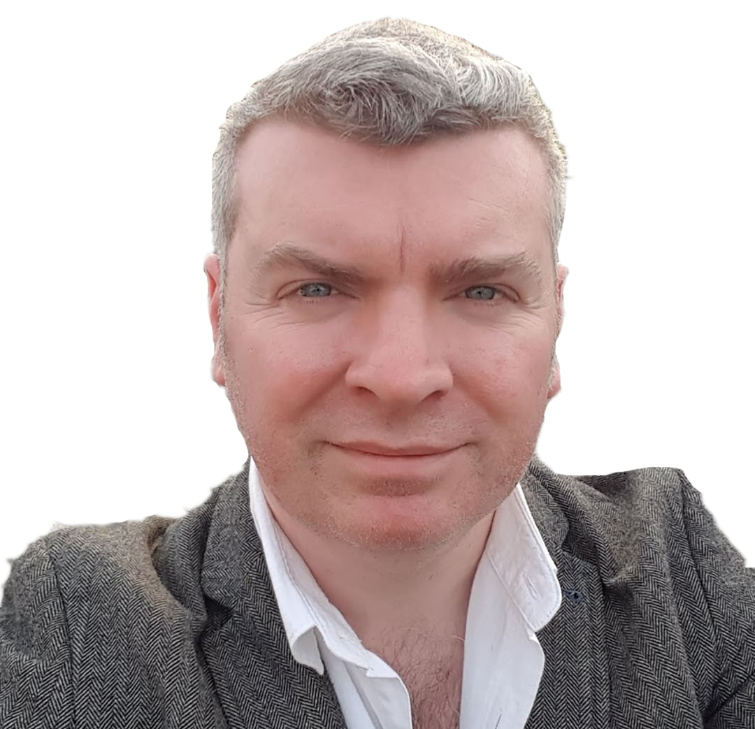
Azure Percept Home Automation
Sat, May 28 | 1PM ET | 5PM PT
Livestream event
Peter Gallagher
IoT Consultant – PJG Creations Ltd

Slide 2
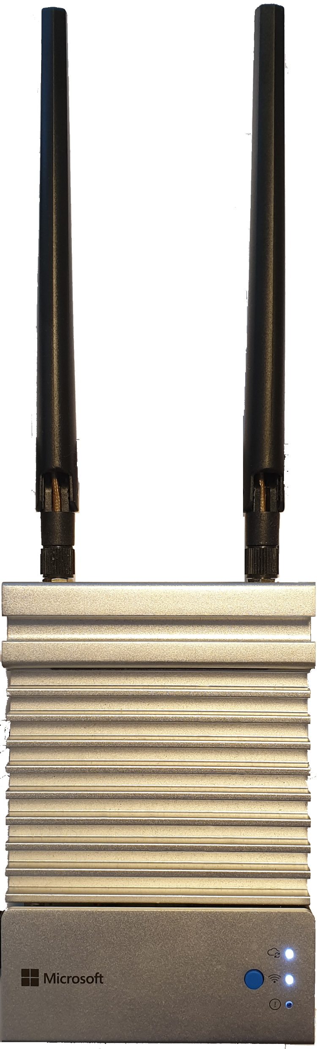
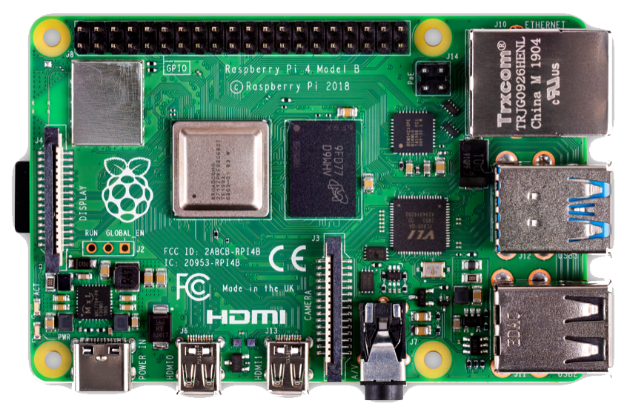
Azure Percept Home Automation
Pete Gallagher
Petecodes.co.uk / pjgcreations.co.uk

Slide 3
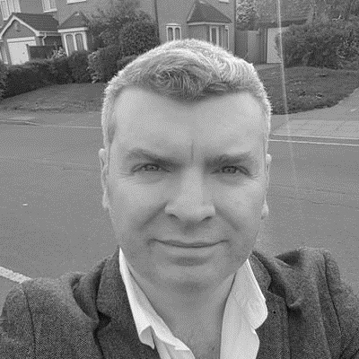
About Me
Pete Gallagher @pete_codes
www.PeteCodes.co.uk
peter.gallagher@octopus.com
Senior Solutions Architect at Octopus Deploy
Microsoft Certified Trainer & Azure MVP, Pluralsight Author
Decades of Desktop, Web & Embedded Software experience,
Meetup Organiser,
STEM Ambassador, Code Club Organiser … Gadget Addict
Father of two inquisitive girls

Slide 4


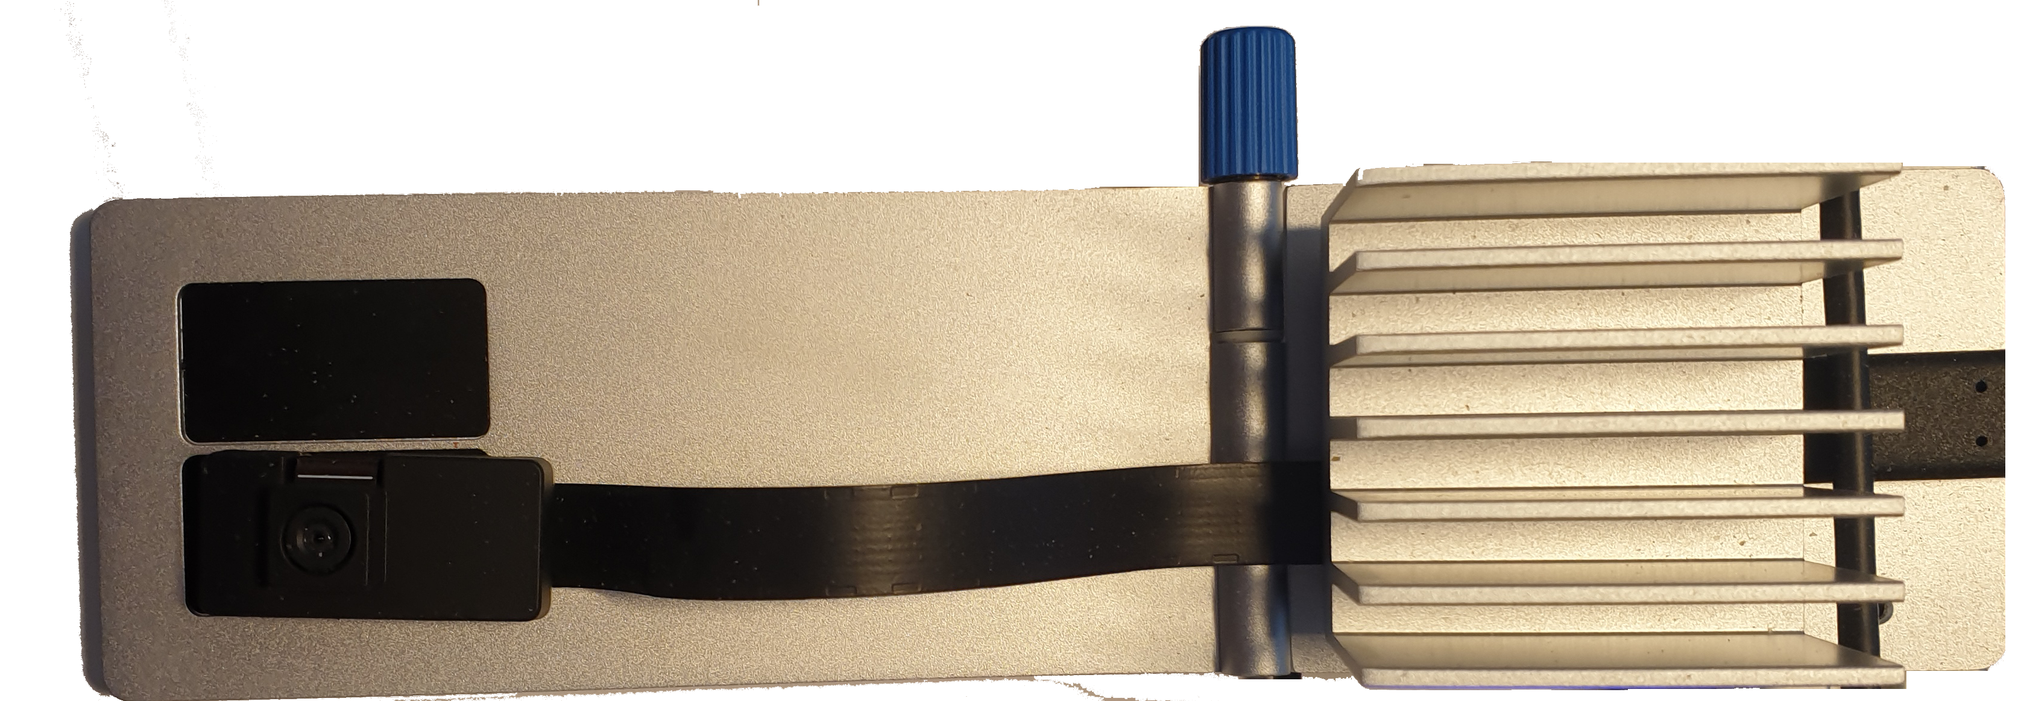


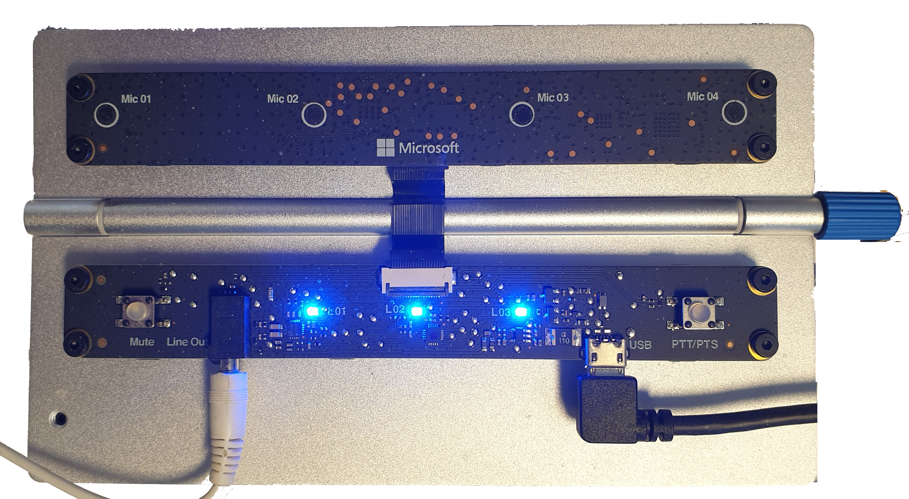
Azure Percept

Slide 5
Azure Percept Hardware
Audio Module
Carrier Board
Vision Module

Slide 6
Azure Percept – Carrier Board
NXP iMX8m processor
Trusted Platform Module (TPM) version 2.0
Wi-Fi and Bluetooth connectivity
1x Ethernet 2x USB-A 3.0 1x USB-C
Microsoft CBL-Mariner Linux Distro
Microsoft Azure IoT Edge
Percept Studio

Slide 7
Azure Percept – Vision Module
Intel Movidius Myriad X (MA2085) Vision Processing Unit (VPU) with Intel Camera ISP integrated @ 0.7 TOPS
Sony IMX219 Camera sensor with 6P Lens
8MP at 30FPS
50cm to infinity focussing
120 degree Field of View
Custom Vision
No Code AI Solution

Slide 8
Azure Percept – Audio Module
XMOS XUF208 Codec
4x MEM Sensing Microsystems Microphones Linear Array
3.5 mm Audio Out
Speech Services and Azure Speech Studio
No Code AI Solution

Slide 9
Azure Percept Components
Speech Services and Speech Studio
IoT Hub and Edge
Custom Vision

Slide 10
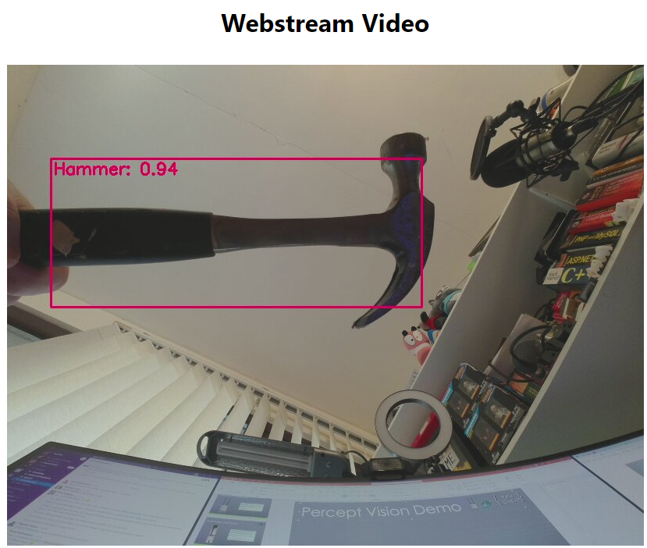
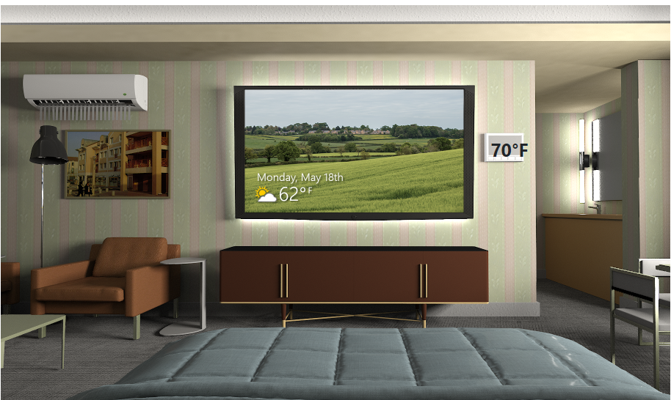
Percept Vision and Audio Demos

Slide 11
Percept Home Automation

Slide 12
Percept Home Automation
Azure Percept Audio
IoT Hub
Raspberry Pi
Mains Relay
Desk Lamp
Speech
Azure Function

Slide 13
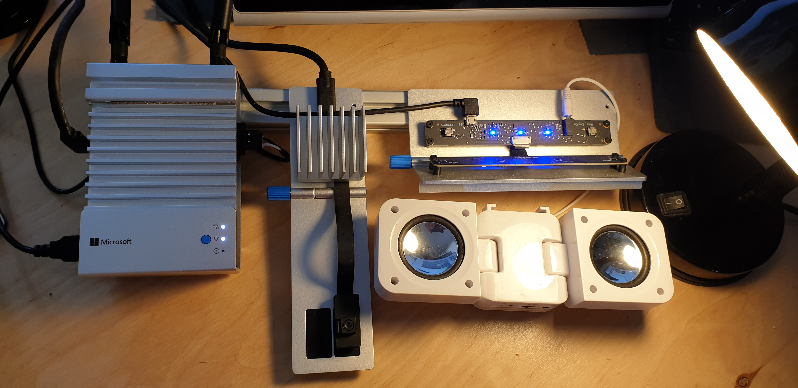
Percept Home Automation Demo

Slide 14
Links
Blog Post https://bit.ly/percept-home-automation
GitHub Repo https://bit.ly/percept-home-automation-repo
Azure Percept http://bit.ly/azure-percept
Azure Speech Services http://bit.ly/azure-speech-services
Azure Custom Vision http://bit.ly/azure-custom-vision
Cloud Skills Challenge https://aka.ms/StudentDeveloperDayChallenge

Slide 15
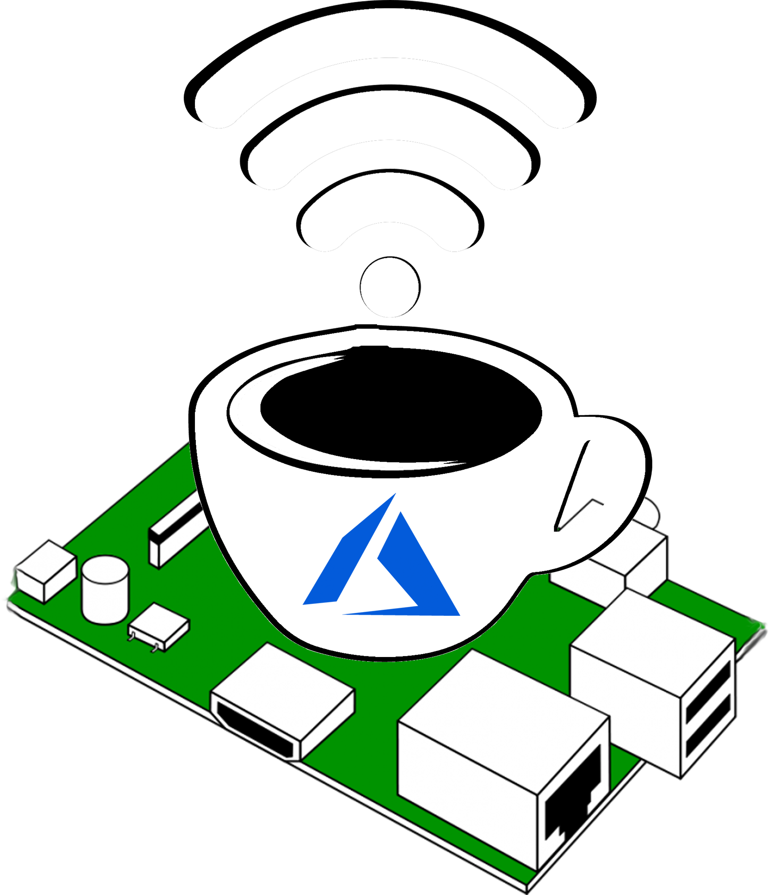
IoTeaLive
https://twitch.tv/azureishlive

Slide 16
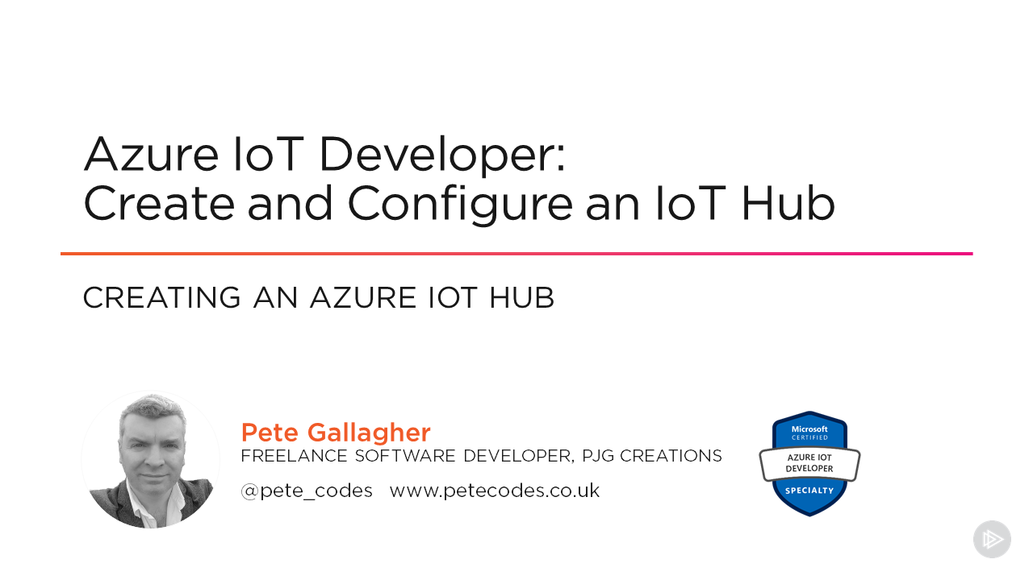
pluralsight.pxf.io/az220

Slide 17
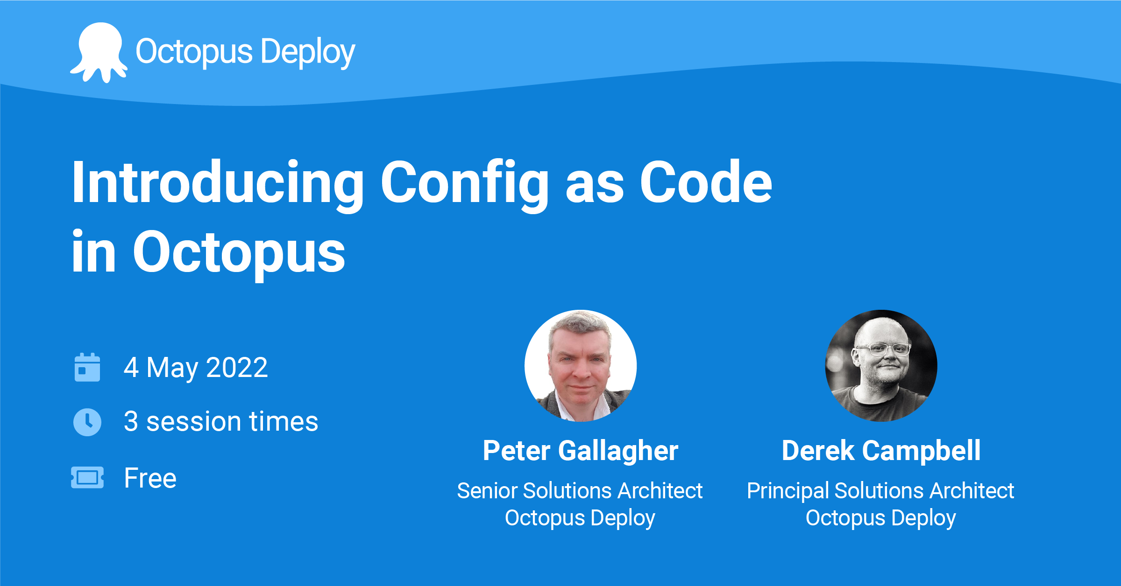

Slide 18
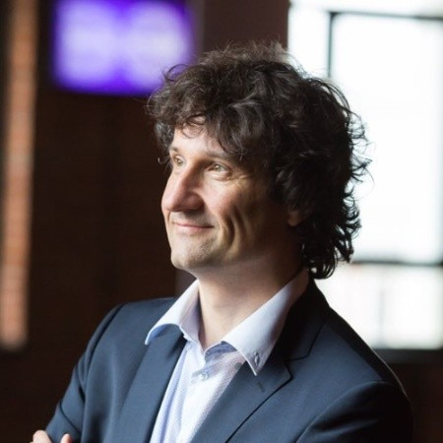
Thursday 12th May from 18:30 BST ON ZOOM!
.NET nanoFramework
Laurent Ellerbach Principle Software Engineer - Microsoft

Slide 19
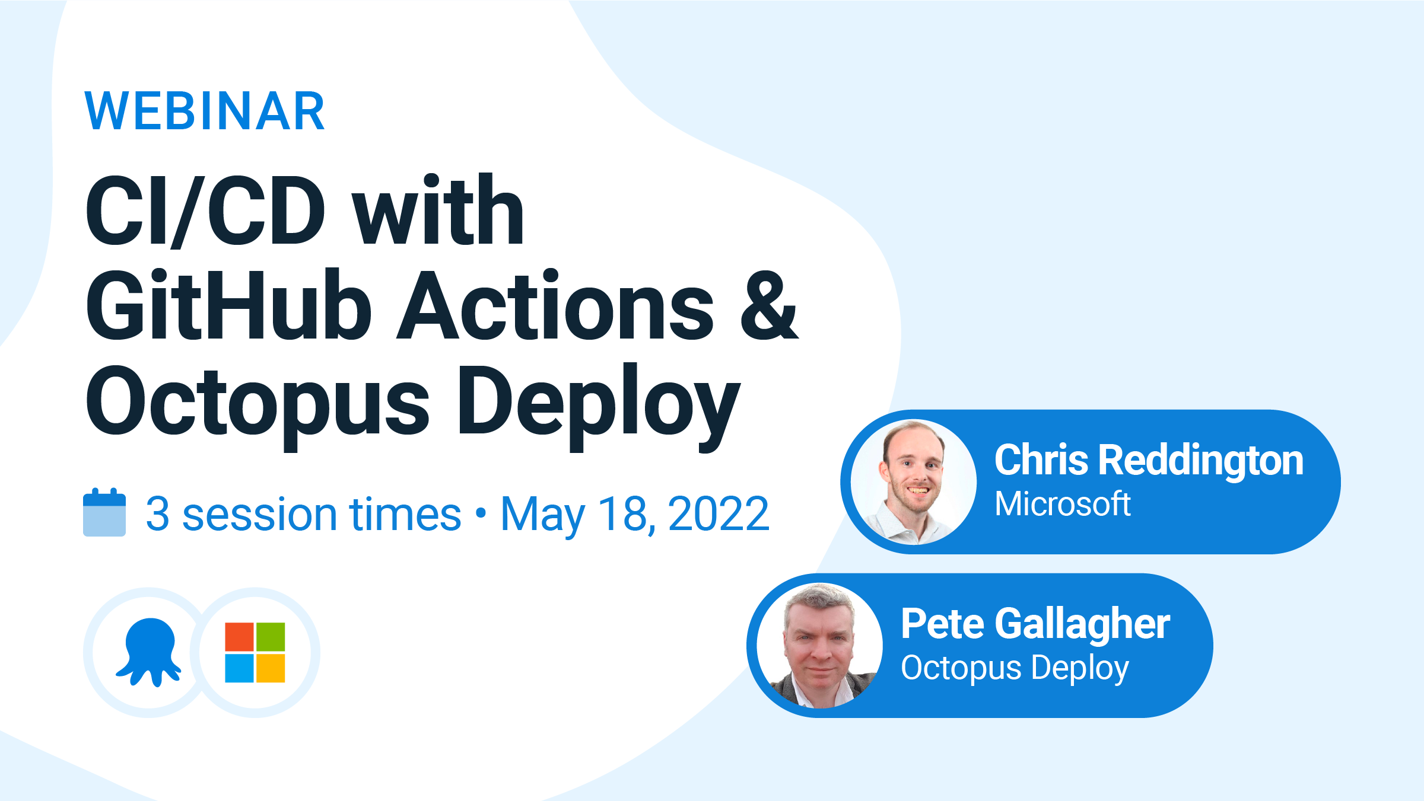

Slide 20
Contact Me
Twitter @pete_codes
Email: peter.gallagher@octopus.com
Personal Website: https://www.petecodes.co.uk Notts IoT: https://www.nottsiot.co.uk
Dot Net Notts: https://www.dotnetnotts.co
Notts Dev Workshop: https://www.nottsdevworkshop.co.uk
LATi: https://www.lati.org.uk
Agile Engineering Podcast: https://agileengineeringpodcast.com/
Azureish Live: https://www.twitch.tv/azureishlive
Slides: https://bit.ly/pjgai422022

